Slide 1


Name Pronunciation Tool
Team: Deep Cadence
Members: Karthik Peddi, Akshaya Das, Chaitanya Rai, Shreyas V, Vijay Lather

Slide 2

Core Ideas Implemented
Any Wells Fargo employee can get the proper pronunciation of name of any other employee of Wells Fargo in the Home page of the Tool.
A Wells Fargo employee can get the standard pronunciation of his/her name and if not happy with it can upload a custom pronunciation to the tool.
If the user wants to hear the standard pronunciation in a different voice / accent or with different speed and pitch, he can do so by exploring various options. If he likes some options specifically, he can choose to save those preferences.
The user when entering a name can hear the non-standard custom preferences/recording of employee if present or choose to hear the standard pronunciation.
An admin can maintain pronunciations in the system by deleting recordings/ adding new users and deleting users.
The user if he chooses to do so can delete his custom recording and revert to the standard recording in the future.
Any user can opt-out of the name pronunciation service can will be deleted from the database.

Slide 3
Additional / Out-of-box Ideas Implemented
The system uses intelligent locale detection models to automatically detect the locale (country) of the name entered and even if the user doesn’t select any country the system will return a natural sounding pronunciation.
If multiple employees in Wells Fargo have same name, each of them can store a different custom recording/preferences and can also enter their preferred name. For example, two employees Ganesan Rajamani are present one of them prefers to be called as Ganesh and the other to be called as Ganesan.
Don’t feel left out if you are not officially a Wells Fargo employee yet! You can always search the pronunciation of your upcoming contact in Wells Fargo as our system allows users to search without logging in.
Same is the case for searching pronunciations of non-Wells Fargo employees you can always get the pronunciation of your interviewee right! Our system allows you to get the pronunciation of non-employees as well. Although they won’t be able to save a custom recording you get to experience the power of our locale detection.

Slide 4
Additional / Out-of-box Ideas Implemented
Are you the product owner of a different product in Wells Fargo, and want to use this API to embed recordings into portals like Teamworks? Don’t worry! Our tool allows users to get an embed code (audio tag) given a name that can simply be plugged in beside the name field in any static or dynamic HTML webpage.
Our system generates High Fidelity audio files with little distortion and life-like sounding voices which are close to actual pronunciations.

Slide 5
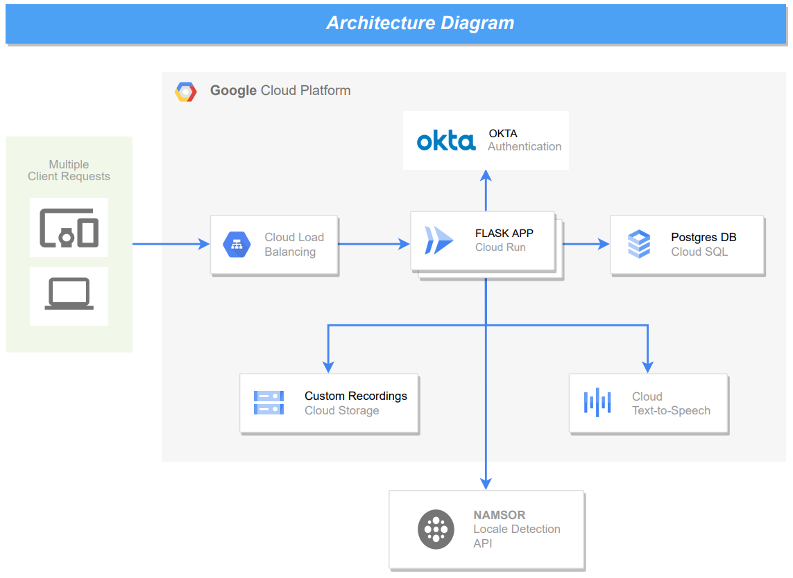
Design Flow

Slide 6
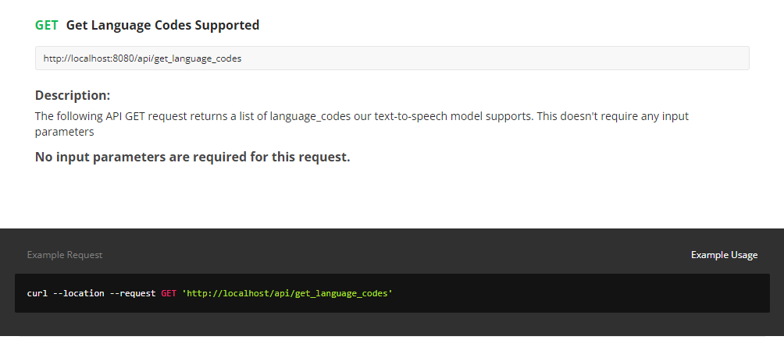

Slide 7
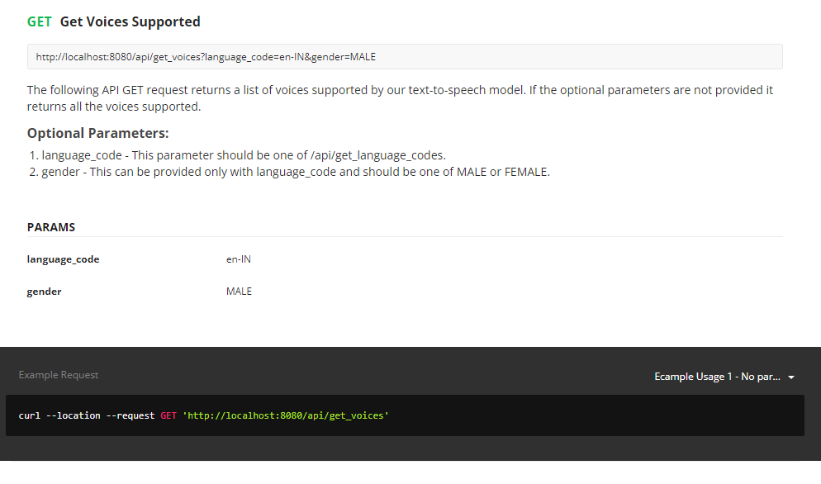

Slide 8
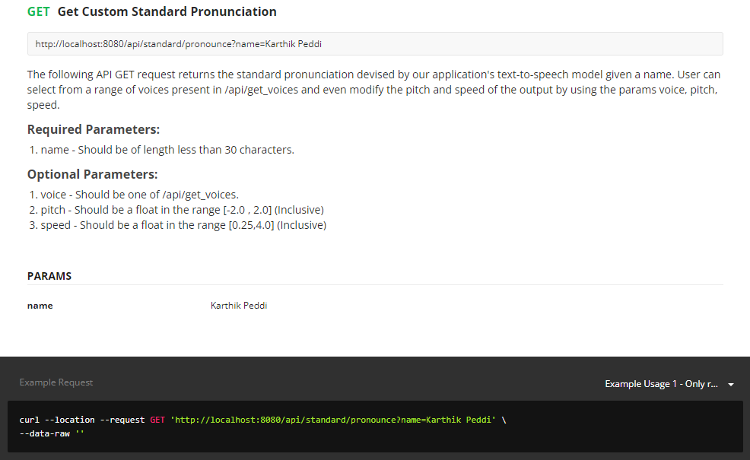

Slide 9
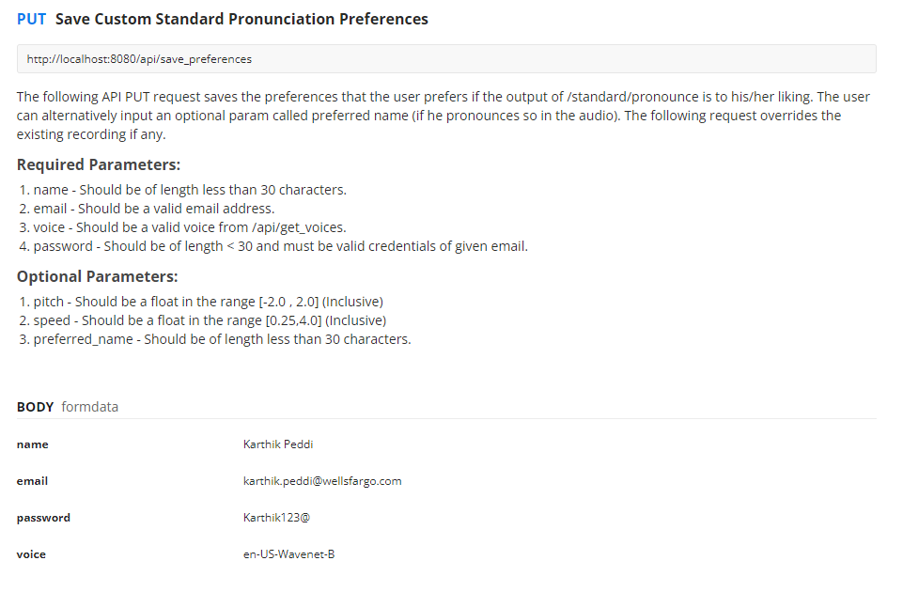

Slide 10
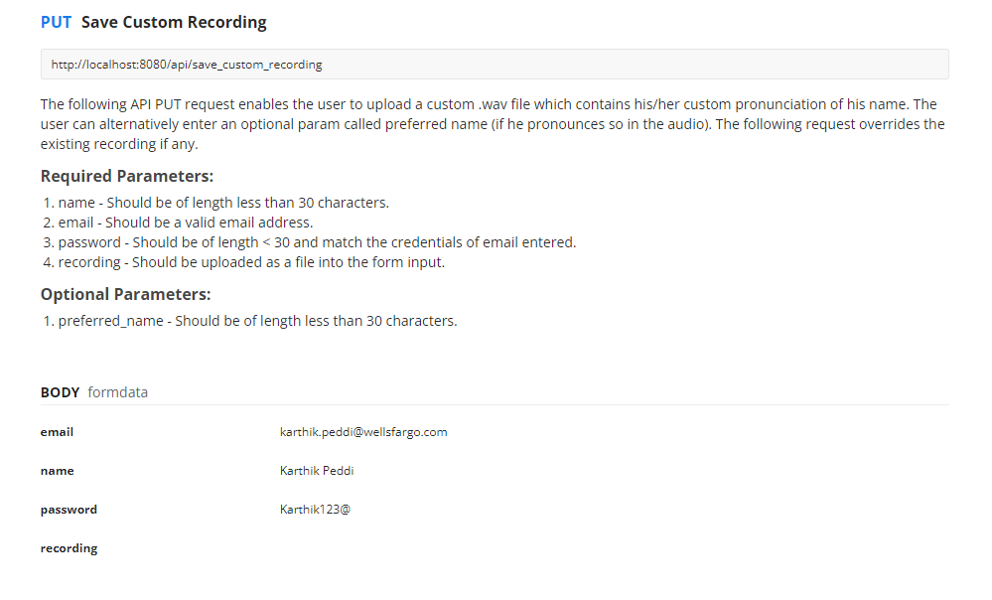

Slide 11
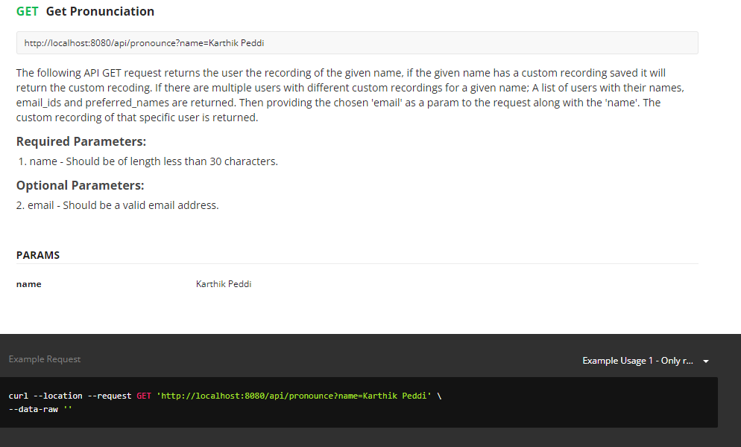

Slide 12
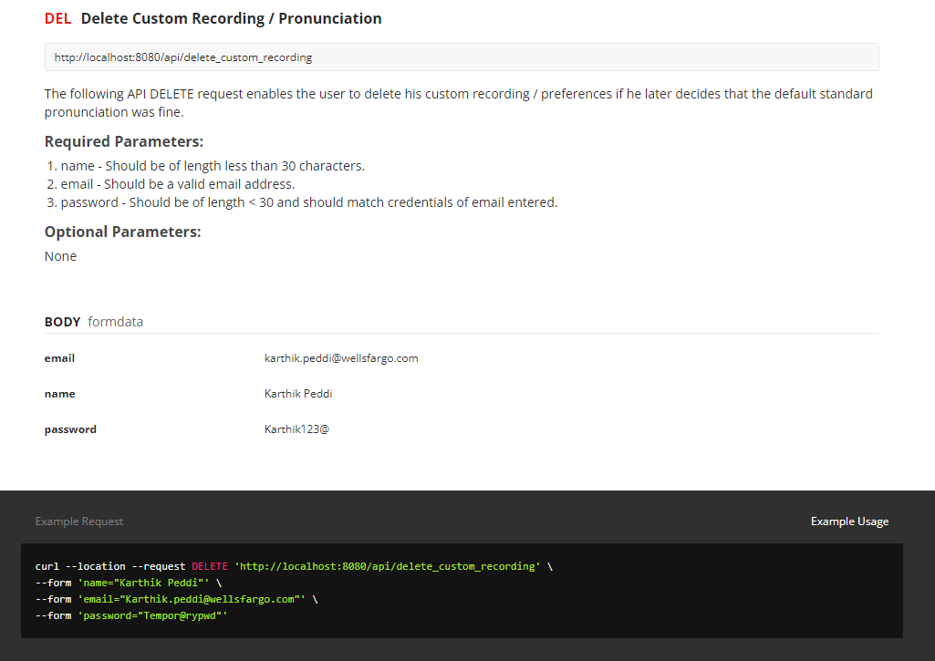

Slide 13
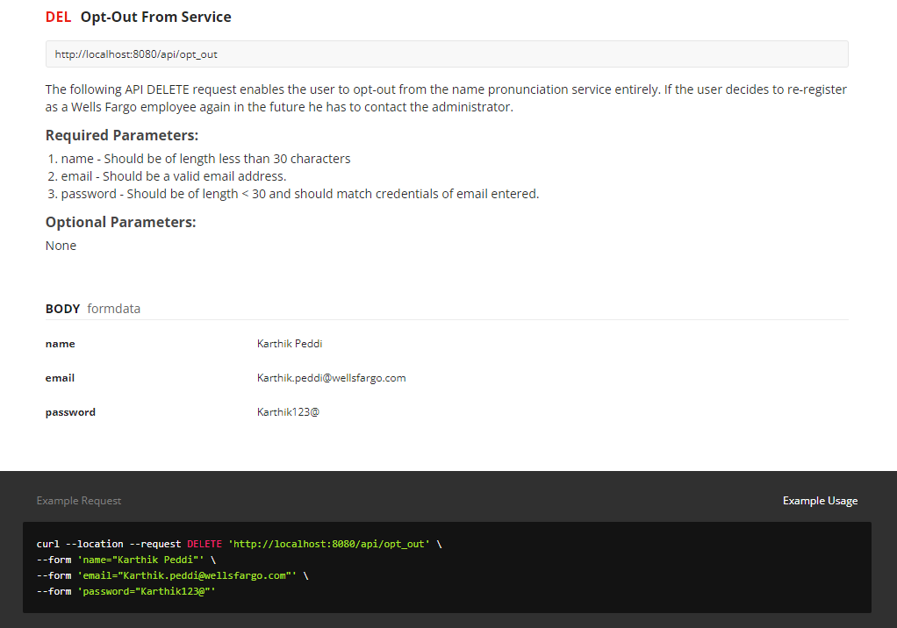

Slide 14
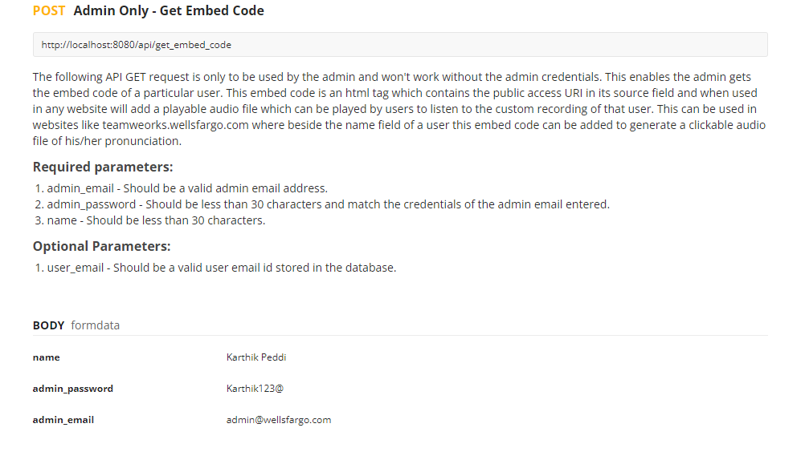

Slide 15
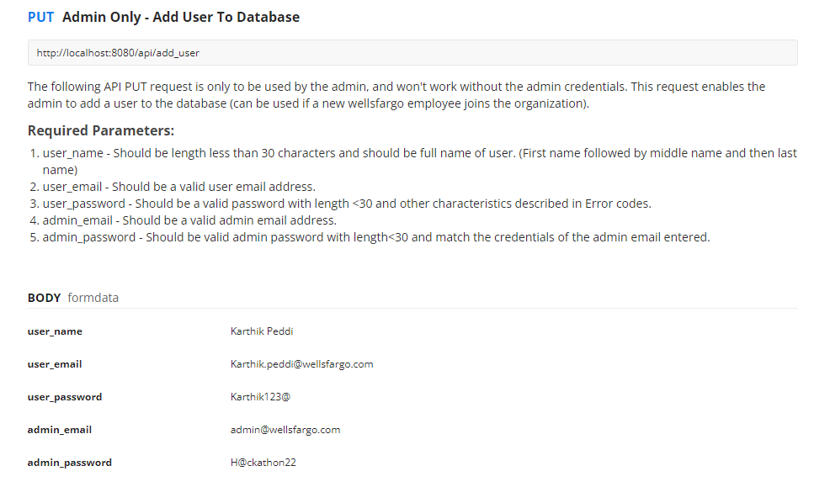

Slide 16
